Slide 1

Lecture 4: Hydrogen Atom
http://www.moleculestothemax.com/

Slide 2
What have we learnt?
Formulate a correct Hamiltonian
(energy) Operator H
Solve TISE HΨ=E Ψ
by separation of variables and intelligent trial wavefunction
Impose boundary conditions for eigenfunctions and obtain Quantum numbers
Eigenstates or Wavefunctions:
Should be “well behaved” -
Normalization of Wavefunction
Probabilities and Expectation Values

Slide 3
Recapitulation: Basics of Quantum Mechanics
Schrödinger equation: Classical wave equation for
de Broglie waves
Eigenvalue equation:
Expectation values:
Boundary conditions: Quantization

Slide 4
Recapitulation: Free Particle
No Quantization, all energies are allowed

Slide 5
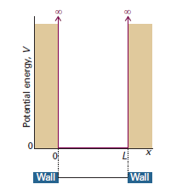
Recapitulation: Particle in 1-D Square-Well Potential
Boundary Conditions:
Normalization:

Slide 6

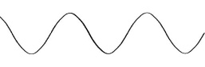
Recapitulation: Particle in 2-D Square-Well Potential
V=0
L_{y}
L_{x}
Square Box
⇒ L_{x} = L_{y} = L
Separation of variables

Slide 7

Recapitulation: Particle in 2-D Rectangular-Well Potential
V=0
L_{y}
L_{x}

Slide 8
Recapitulation: Symmetry and Degeneracy
V=0
V=0
L_{y}
L_{y}
L_{x}
L_{x}
(1,3)
(3,1)
(1,3)
(3,2)
(2,2)
(2,2)
(1,2)
(3,1)
(2,1)
(1,2)
(2,1)
(1,1)
(1,1)

Slide 9
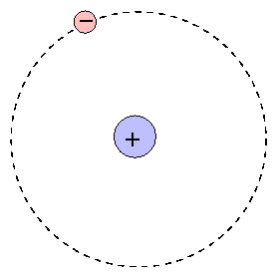
Hydrogen Atom
(x_{e},y_{e},z_{e})
Two particle central-force problem
Completely solvable – a rare example!
(x_{N},y_{N},z_{N})

Slide 10
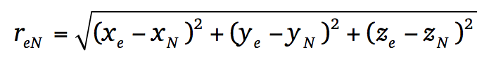
Hydrogen Atom
Schrödinger Equation

Slide 11
Hydrogen Atom: Relative Frame of Reference
Separation of Ĥ into Center of Mass and Internal co-ordinates
z
m_{e}(x_{e},y_{e},z_{e})
r_{e}
r_{eN}
-
CM
M_{N}
(x_{N},y_{N},z_{N})
R
r_{N}
y
x

Slide 12
Hydrogen Atom: Relative Frame of Reference
Checkout Appendix-1

Slide 13
Hydrogen Atom: Separation to Relative Frame
Hydrogen atom has two particles the nucleus and electron with co-ordinates x_{N},y_{N},z_{N} and x_{e},y_{e},z_{e}
The potential energy between the two is function of relative co-ordinates x=x_{e}-x_{N}, y=y_{e}-y_{N}, z=z_{e}-z_{N}
Appendix-1
z
m_{e}(x_{e},y_{e},z_{e})
r_{e}
r_{eN}
-
CM
R
M_{N}
(x_{N},y_{N},z_{N})
r_{N}
y
x

Slide 14
Hydrogen Atom: Separation to Relative Frame
Appendix-1
z
m_{e}(x_{e},y_{e},z_{e})
r_{e}
r_{eN}
-
CM
R
M_{N}
(x_{N},y_{N},z_{N})
r_{N}
y
x

Slide 15
Hydrogen Atom: Separation to Relative Frame
Appendix-1

Slide 16
Hydrogen Atom: Separation to Relative Frame
In the above equation the first term represent the kinetic energy of the center of mass (CM) motion and second term represents the kinetic energy of the relative motion of electron and
Appendix-1

Slide 17
Hydrogen Atom: Separation of CM motion
Free particle!
Kinetic energy of the atom
?

Slide 18
Particle in 2-D Square-Well Potential
Hamiltonian
ψ is a product of the eigenfunctions of the parts of Ĥ
E is sum of the eigenvalues of the parts of Ĥ

Slide 19
Hydrogen Atom: Electronic Hamiltonian
v
v

Slide 20
Hydrogen Atom: Electronic Hamiltonian
Not possible to separate out into three different co-ordinates. Need a new co-ordinate system

Slide 21
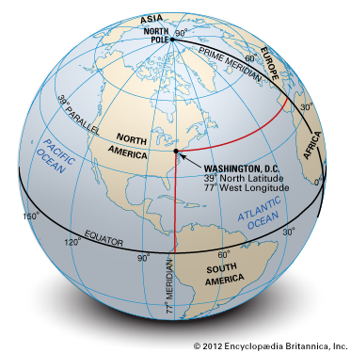
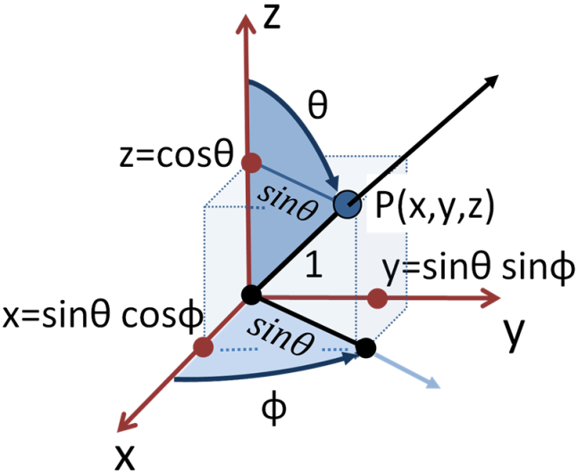
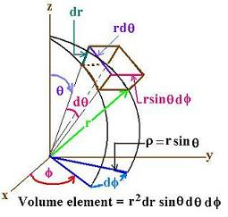
Spherical Polar Co-ordinates
r:0 to ∞
θ: 0 to π
φ: 0 to 2π

Slide 22
Laplacian in Spherical Coordinates

Slide 23
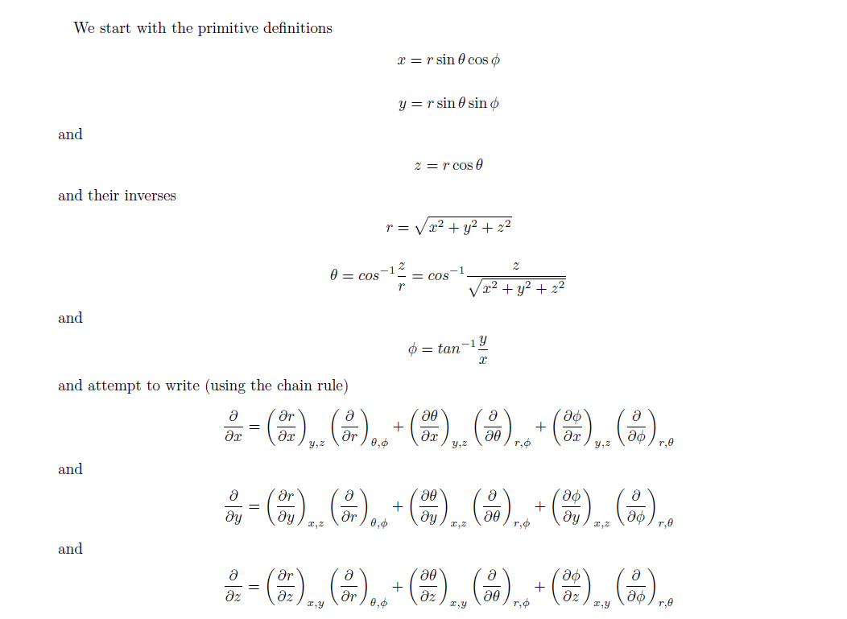
Laplacian in Spherical Coordinates
Appendix-2

Slide 24
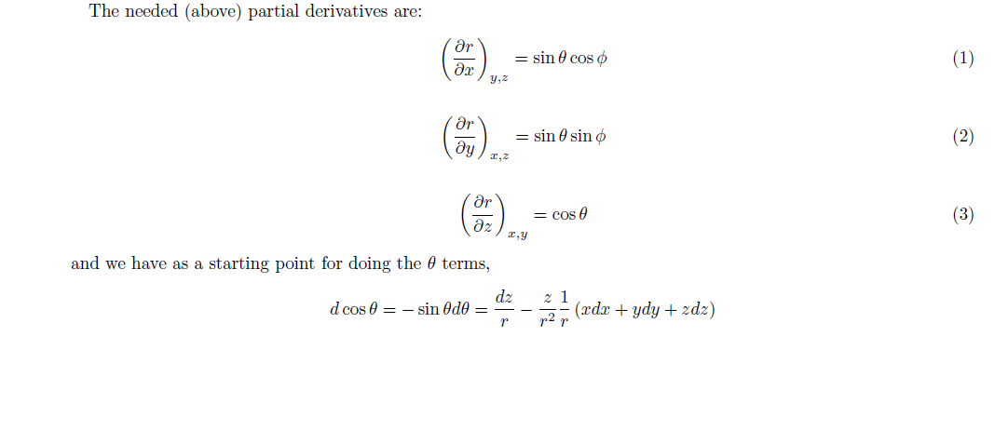
Laplacian in Spherical Coordinates
Appendix-2

Slide 25
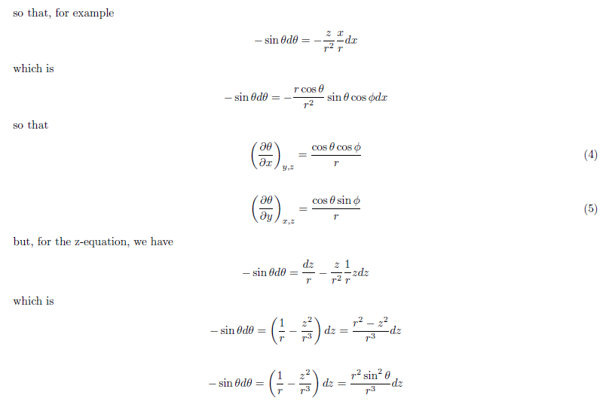
Laplacian in Spherical Coordinates
Appendix-2

Slide 26
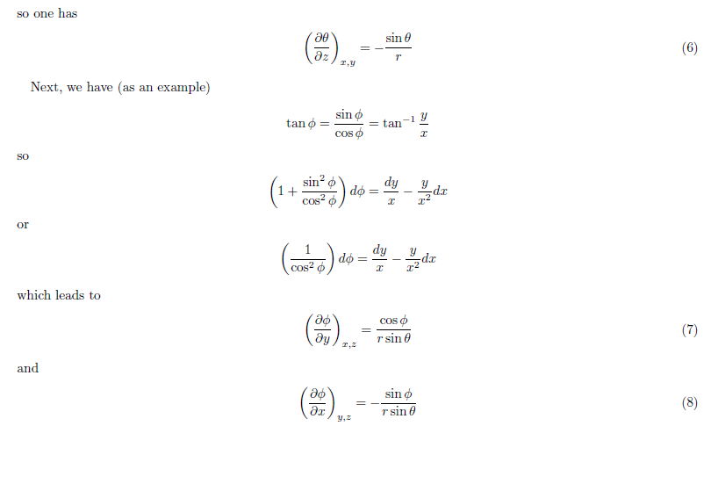
Laplacian in Spherical Coordinates
Appendix-2

Slide 27
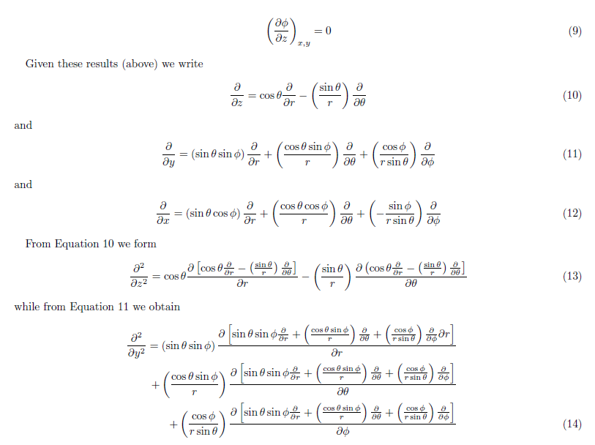
Laplacian in Spherical Coordinates
Appendix-2

Slide 28
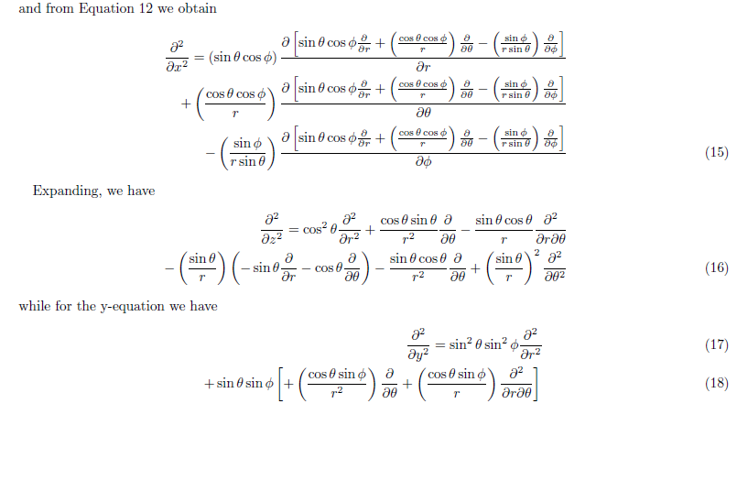
Laplacian in Spherical Coordinates
Appendix-2

Slide 29
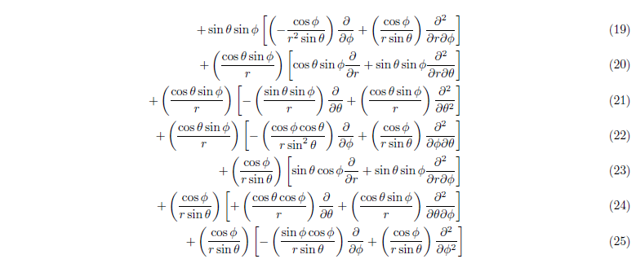
Laplacian in Spherical Coordinates
Appendix-2

Slide 30
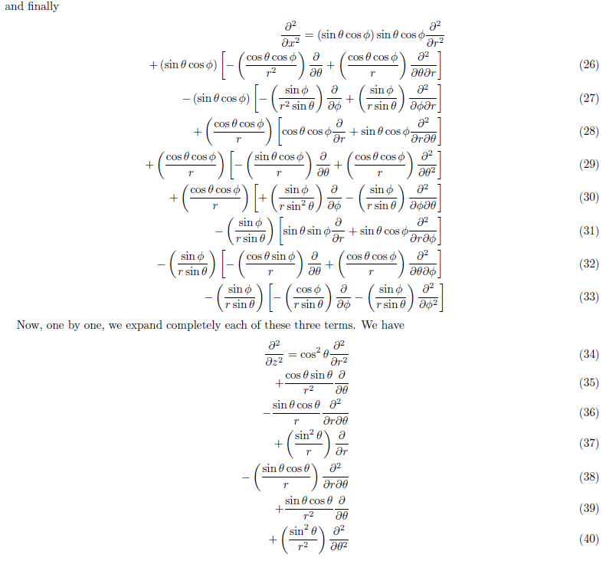
Laplacian in Spherical Coordinates
Appendix-2

Slide 31
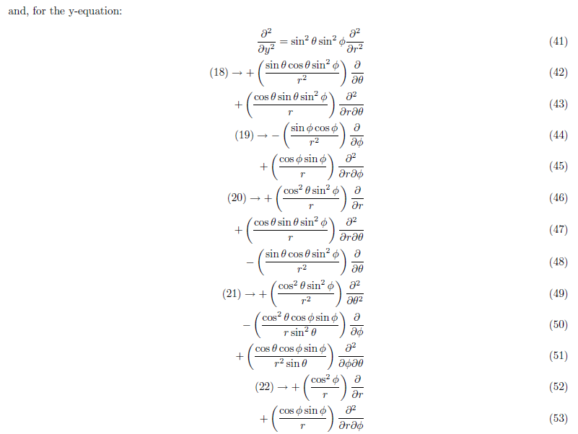
Laplacian in Spherical Coordinates
Appendix-2

Slide 32
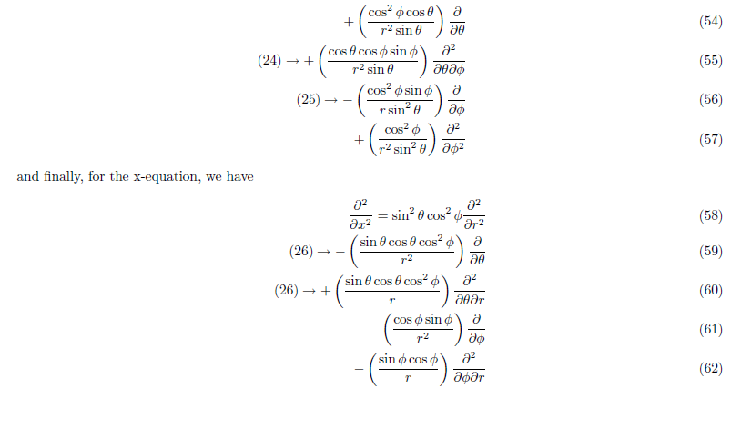
Laplacian in Spherical Coordinates
Appendix-2

Slide 33
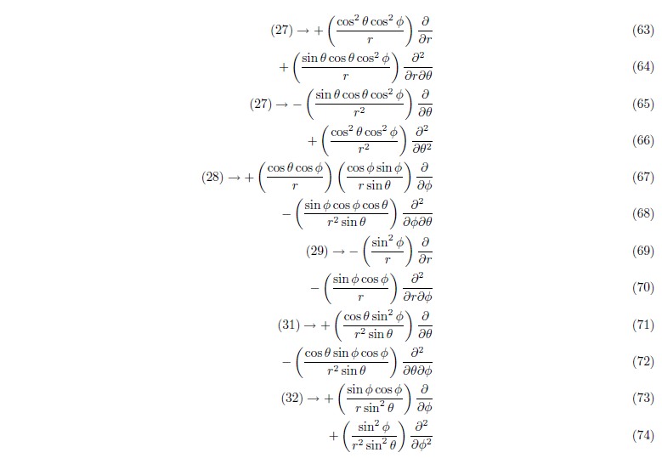
Laplacian in Spherical Coordinates
Appendix-2

Slide 34
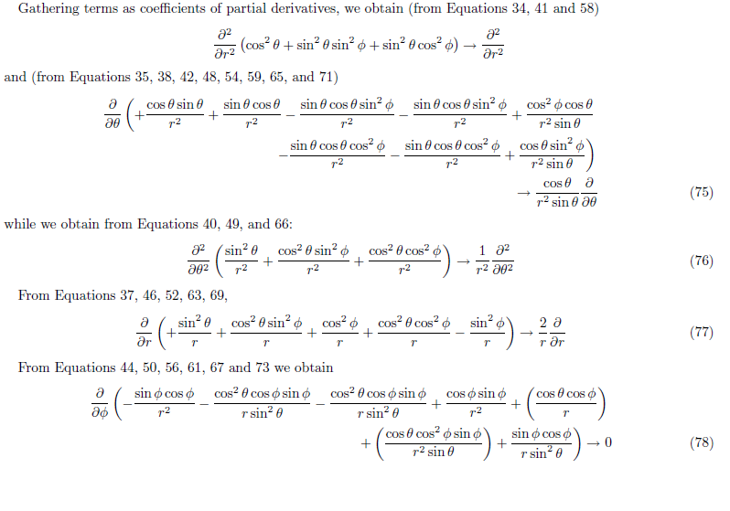
Laplacian in Spherical Coordinates
Appendix-2

Slide 35
Laplacian in Spherical Coordinates

Slide 36
Hamiltonian in Spherical Coordinates

Slide 37
Schrodinger equation for the electronic part in Spherical Polar Co-ordinates
and bring all the terms to the LHS

Slide 38
Separation of variables

Slide 39
Separation of variables
Upon differentiation

Slide 40
Separation of variables

Slide 41
Separation of variables
Radial
Angular
=β
A constant
Notes:
Till here in 4th lecture

Slide 42
Schrodinger Equation
Time-dependent Schrodinger equation

Slide 43
Schrodinger Equation
LHS is a function of co-ordinates and RHS is function of time. If these two have to be equal then both functions must be equal to constant, say W

Slide 44
Schrodinger Equation
Separation of variables
The solution of the differential equation

Slide 45
Separation of variables
Radial equation
Angular equation

Slide 46
Separation of variables
Radial equation
Angular equation

Slide 47
Separation of variables
The three variables r, θ and φ are separated

Slide 48
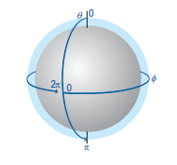
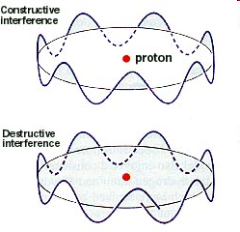
Solution to φ part
Trial solution:
Wavefunction has to be continuous
‘φ’ ranges from 0 to 2π
Periodic Boundary Condition

Slide 49
Solution to φ part
cos (2πm) + i sin (2πm) = 1
z
True only if m=0, ±1, ±2, ±3, ±4,….
What kind of information does Φ contain?
x
Change in φ: Circular motion in xy plane
z – component of angular momentum?
y

Slide 50
Angular momentum: from classical to quantum picture
Is Φ an eigenfunction?

Slide 51
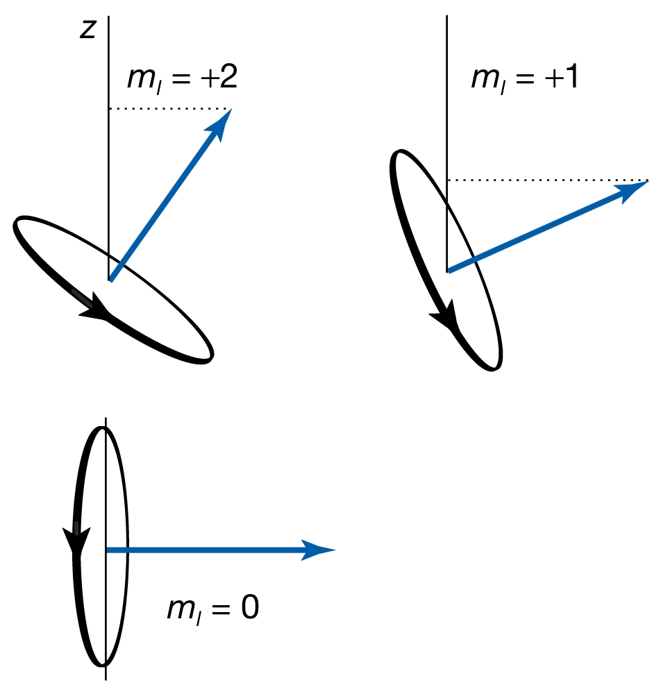
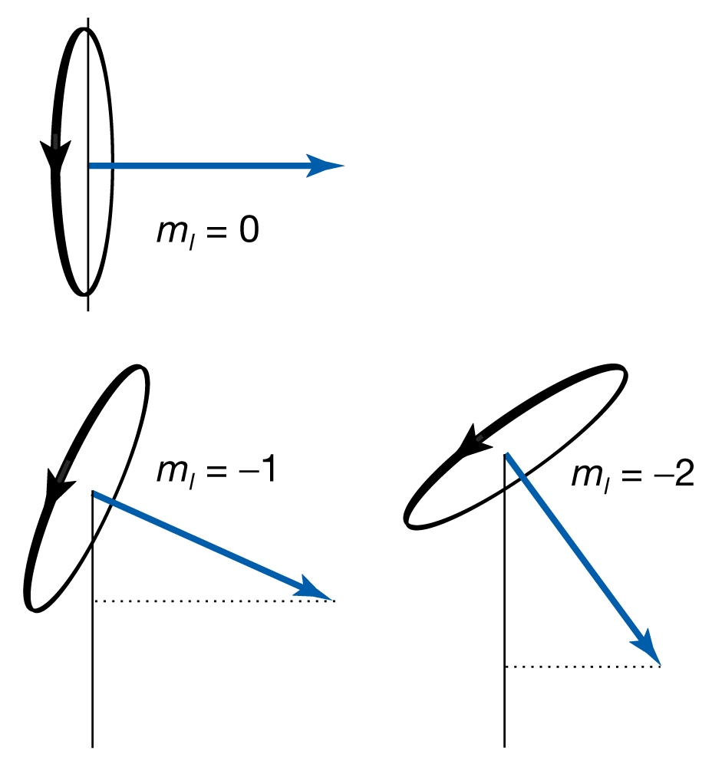
Moment of truth
z-component of angular momentum
m: Magnetic Quantum Number
“Space Quantization”

Slide 52
Solution to φ part
cos (2πm) + i sin (2πm) = 1
True only if m=0, ±1, ±2, ±3, ±4,….
m is the “magnetic quantum” number
m is restricted by another quantum number (orbital Angular momentum), l, such that |m|<l

Slide 53
The Θ and the R part
Solve to get R(r)
Solve to get Θ(θ)
Need serious mathematical skill to solve these two equations. We only look at solutions

Slide 54
The Θ part
Solution to Θ(θ) :
l=0,1,2,3…
:Associated Legendre Polynomials
New quantum number ‘l’ : orbital / Azimuthal quantum number
Restriction on m≤l
is due to this equation

Slide 55
The angular (Θ·Φ) part
The angular part of the solution
are called spherical harmonics
l=0,1,2,3…
m=0, ±1, ±2, ±3… and |m|≤l

Slide 56
The R part
Solution to R(r) are
Restriction on l<n
Where are called associated Laguerre functions
The new quantum number is ‘n’ called principal quantum number

Slide 57
Energy of the Hydrogen Atom
Energy is dependent only on ‘n’
Energy obtained by full quantum mechanical treatment is equal to Bohr energy
Potential energy term is only dependent on the Radial part and has no contribution from the Angular parts

Slide 58
Quantum Numbers of Hydrogen Atom
n Principal Quantum number
Specifies the energy of the electron
l Orbital Angular Momentum Quantum number
Specifies the magnitude of the electron's orbital angular momentum
m Z-component of Angular Momentum Quantum number
Specifies the orientation of the electron's orbital angular momentum
s Orbital Angular Momentum Quantum number
Specifies the orientation of the electron's spin angular momentum

